Slide 1
This Diary belongs to
Katherine Robertson
Hover over stickers to interact!

Slide 2
Hover over to begin reading!
Diary Date List
Thursday, 12th August 2000
Sunday, 14th August 2000
Monday, 15th August 2000
Wednesday, 17th August 2000
Friday, 19th August 2000
This Diary belongs to
Katherine Robertson
Click to return to this Diary Date List

Slide 3
Diary Date List
Thursday, 12th August 2000
Sunday, 14th August 2000
Monday, 15th August 2000
Wednesday, 17th August 2000
Friday, 19th August 2000
This Diary belongs to
Katherine Robertson
Click on a date to read the entry for that date.
Click to return to this Diary Date List

Slide 4
Thursday, 12th August 2000
Today we left for our vacation.

Slide 5
Thursday, 12th August 2000
Today we left for our vacation.
Mummy couldn’t come because she stayed home to look after Daddy. I was worried it would be weird. I’m not the most social person, whether they’re my sisters or not, it’s difficult…
Today was fine, fun actually. The car ride was entertaining. It was a really long drive though.

Slide 6
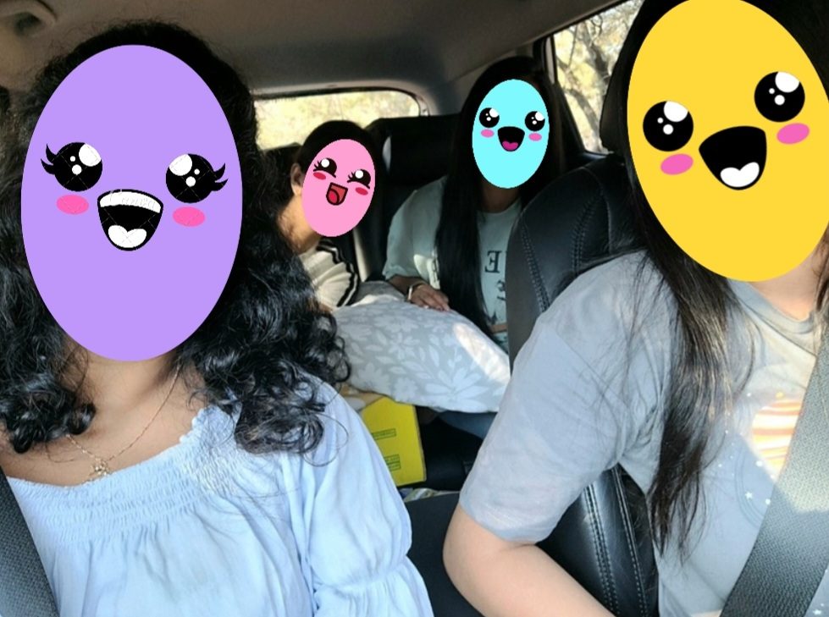

Slide 7
Thursday, 12th August 2000
Today we left for our vacation.
Mummy couldn’t come because she stayed home to look after Daddy. I was worried it would be weird. I’m not the most social person, whether they’re my sisters or not, it’s difficult…
Today was fine, fun actually. The car ride was entertaining. It was a really long drive though.
I was the designated navigator, which surprised me cos they usually say I’m bad at directions. I’m not though, I just get so nervous that I just say yes to everything they ask.

Slide 8
Thursday, 12th August 2000
Today we left for our vacation.
Mummy couldn’t come because she stayed home to look after Daddy. I was worried it would be weird. I’m not the most social person, whether they’re my sisters or not, it’s difficult…
Today was fine, fun actually. The car ride was entertaining. It was a really long drive though.
I was the designated navigator, which surprised me cos they usually say I’m bad at directions. I’m not though, I just get so nervous that I just say yes to everything they ask.
Anyway, I didn’t mess up today! The worst part was the 20km dirt road though. But it was fun. We had such a laugh with
all the bumps and potholes and everything.

Slide 9
Thursday, 12th August 2000
Today we left for our vacation.
Mummy couldn’t come because she stayed home to look after Daddy. I was worried it would be weird. I’m not the most social person, whether they’re my sisters or not, it’s difficult…
Today was fine, fun actually. The car ride was entertaining. It was a really long drive though.
I was the designated navigator, which surprised me cos they usually say I’m bad at directions. I’m not though, I just get so nervous that I just say yes to everything they ask.
Anyway, I didn’t mess up today! The worst part was the 20km dirt road though. But it was fun. We had such a laugh with
all the bumps and potholes and everything.
We didn’t do all that much once we settled down. We watched a movie. It was quite intense, but it was nice! I liked the feminism aspects of it a lot. It’s been such a long time since I’ve had a chance to watch a movie with them…

Slide 10
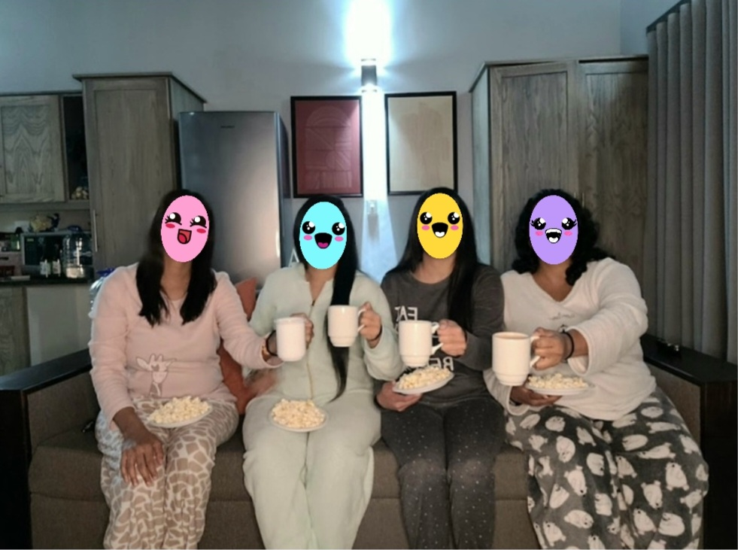
Thursday, 12th August 2000
Today we left for our vacation.
Mummy couldn’t come because she stayed home to look after Daddy. I was worried it would be weird. I’m not the most social person, whether they’re my sisters or not, it’s difficult…
Today was fine, fun actually. The car ride was entertaining. It was a really long drive though.
I was the designated navigator, which surprised me cos they usually say I’m bad at directions. I’m not though, I just get so nervous that I just say yes to everything they ask.
Anyway, I didn’t mess up today! The worst part was the 20km dirt road though. But it was fun. We had such a laugh with

Slide 11
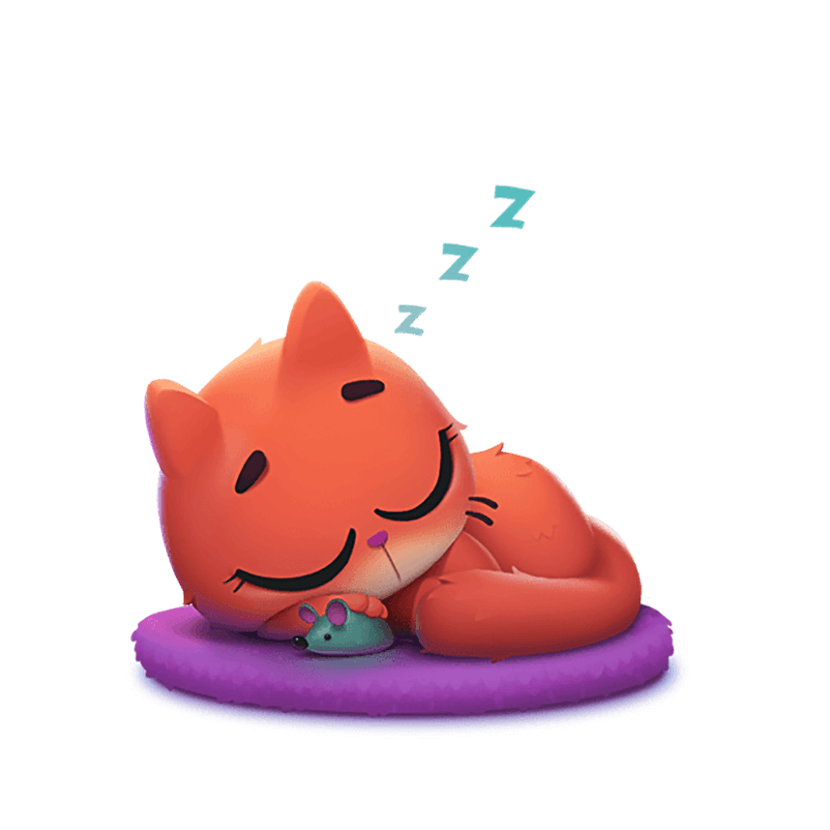
Thursday, 12th August 2000
Today we left for our vacation.
Mummy couldn’t come because she stayed home to look after Daddy. I was worried it would be weird. I’m not the most social person, whether they’re my sisters or not, it’s difficult…
Today was fine, fun actually. The car ride was entertaining. It was a really long drive though.
I was the designated navigator, which surprised me cos they usually say I’m bad at directions. I’m not though, I just get so nervous that I just say yes to everything they ask.
Anyway, I didn’t mess up today! The worst part was the 20km dirt road though. But it was fun. We had such a laugh with
all the bumps and potholes and everything.
We didn’t do all that much once we settled down. We watched a movie. It was quite intense, but it was nice! I liked the feminism aspects of it a lot. It’s been such a long time since I’ve had a chance to watch a movie with them…
We went to bed straight after that, we didn’t realize how tiring the day was.

Slide 12
Thursday, 12th August 2000
Today we left for our vacation.
Mummy couldn’t come because she stayed home to look after Daddy. I was worried it would be weird. I’m not the most social person, whether they’re my sisters or not, it’s difficult…
Today was fine, fun actually. The car ride was entertaining. It was a really long drive though.
I was the designated navigator, which surprised me cos they usually say I’m bad at directions. I’m not though, I just get so nervous that I just say yes to everything they ask.
Anyway, I didn’t mess up today! The worst part was the 20km dirt road though. But it was fun. We had such a laugh with
all the bumps and potholes and everything.
We didn’t do all that much once we settled down. We watched a movie. It was quite intense, but it was nice! I liked the feminism aspects of it a lot. It’s been such a long time since I’ve had a chance to watch a movie with them…
We went to bed straight after that, we didn’t realize how tiring the day was.
I really hope tomorrow is fine too… I just don’t want to disappoint them or let them think I’m a monster like they used to…

Slide 13
Sunday, 14th August 2000
3 days. It took me 3 days to fuck up.
They tried to play it off as if nothing had happened, I did too just so I didn’t lose it, but fuck… 3 days?

Slide 14
Sunday, 14th August 2000
3 days. It took me 3 days to fuck up.
They tried to play it off as if nothing had happened, I did too just so I didn’t lose it, but fuck… 3 days?
We went for a ride around the safari on quadbikes, I was really nervous for it. The last time I went was really fun, but this time I just had a bad feeling about it all day.

Slide 15
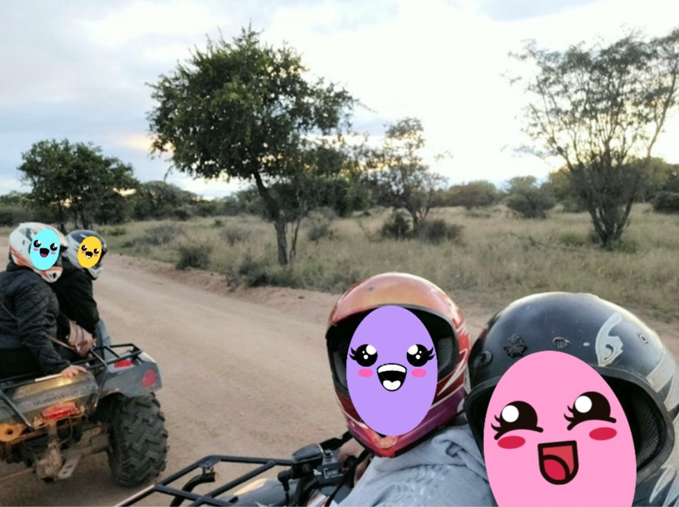

Slide 16
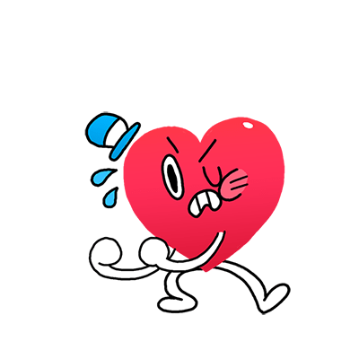
Sunday, 14th August 2000
3 days. It took me 3 days to fuck up.
They tried to play it off as if nothing had happened, I did too just so I didn’t lose it, but fuck… 3 days?
We went for a ride around the safari on quadbikes, I was really nervous for it. The last time I went was really fun, but this time I just had a bad feeling about it all day.
Our guide was not the best. He didn’t communicate anything to us!
From when we were stopping to pointing out some of the animals or even just making sure we were all together and no one was lost.

Slide 17
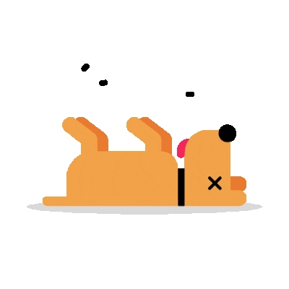
Sunday, 14th August 2000
3 days. It took me 3 days to fuck up.
They tried to play it off as if nothing had happened, I did too just so I didn’t lose it, but fuck… 3 days?
We went for a ride around the safari on quadbikes, I was really nervous for it. The last time I went was really fun, but this time I just had a bad feeling about it all day.
Our guide was not the best. He didn’t communicate anything to us!
From when we were stopping to pointing out some of the animals or even just making sure we were all together and no one was lost.
Because he was so bad, I bumped into the quad in front of me. And of course, it was my sister’s. I’m almost certain the brakes were
bad because I pressed it as soon as I saw that they had stopped, but I still went into them.
I heard the giggles and laughs from the shitty people behind, and I just wanted to die…

Slide 18
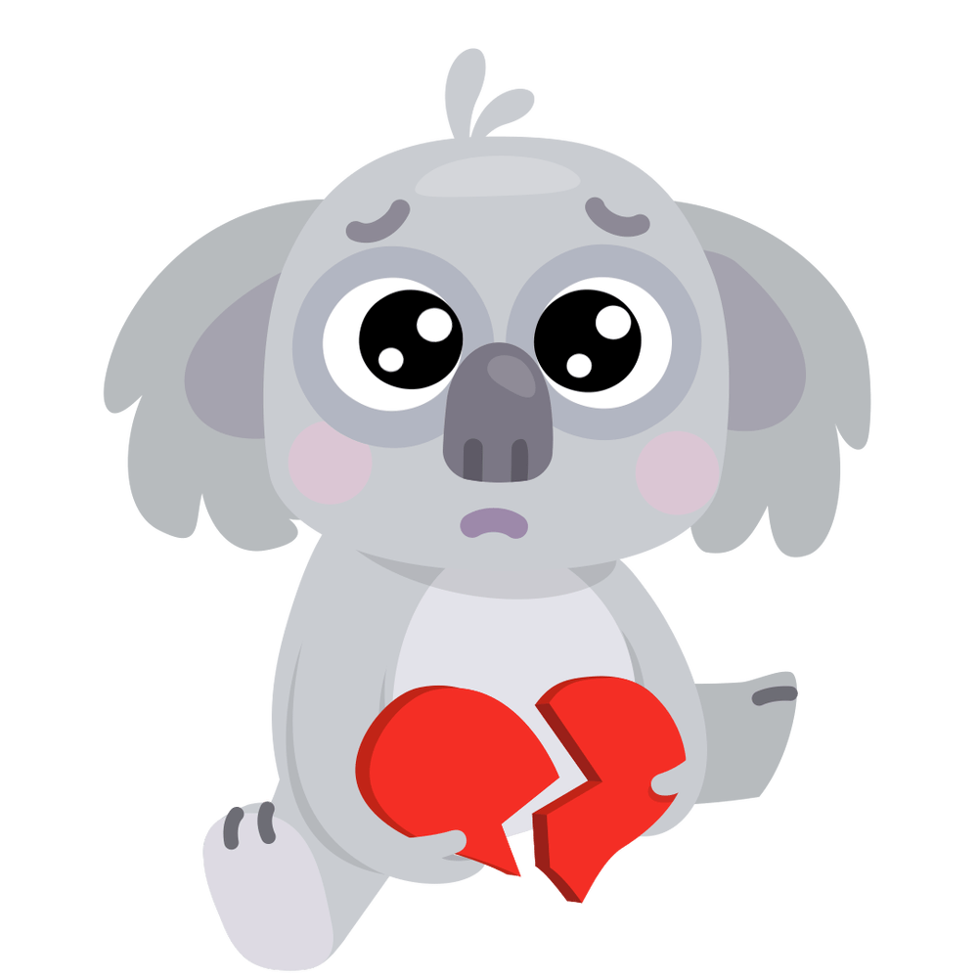
Sunday, 14th August 2000
3 days. It took me 3 days to fuck up.
They tried to play it off as if nothing had happened, I did too just so I didn’t lose it, but fuck… 3 days?
We went for a ride around the safari on quadbikes, I was really nervous for it. The last time I went was really fun, but this time I just had a bad feeling about it all day.
Our guide was not the best. He didn’t communicate anything to us!
From when we were stopping to pointing out some of the animals or even just making sure we were all together and no one was lost.
Because he was so bad, I bumped into the quad in front of me. And of course, it was my sister’s. I’m almost certain the brakes were
bad because I pressed it as soon as I saw that they had stopped, but I still went into them.
I heard the giggles and laughs from the shitty people behind, and I just wanted to die…
I tried my hardest not to cry or show my disappointment in myself…
Why do I have to be so useless at everything? I swear, I’m just a waste of oxygen…

Slide 19
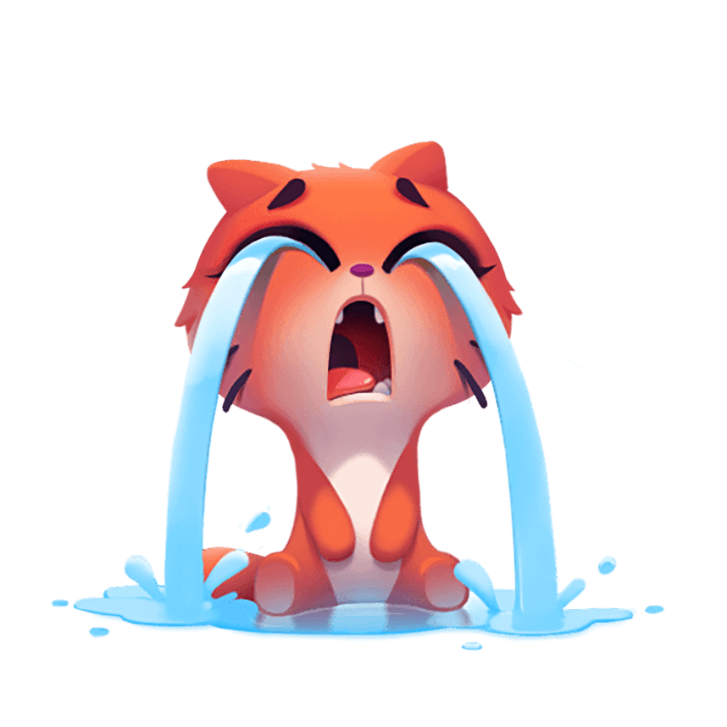
Sunday, 14th August 2000
3 days. It took me 3 days to fuck up.
They tried to play it off as if nothing had happened, I did too just so I didn’t lose it, but fuck… 3 days?
We went for a ride around the safari on quadbikes, I was really nervous for it. The last time I went was really fun, but this time I just had a bad feeling about it all day.
Our guide was not the best. He didn’t communicate anything to us!
From when we were stopping to pointing out some of the animals or even just making sure we were all together and no one was lost.
Because he was so bad, I bumped into the quad in front of me. And of course, it was my sister’s. I’m almost certain the brakes were
bad because I pressed it as soon as I saw that they had stopped, but I still went into them.
I heard the giggles and laughs from the shitty people behind, and I just wanted to die…
I tried my hardest not to cry or show my disappointment in myself…
Why do I have to be so useless at everything? I swear, I’m just a waste of oxygen…
As soon as we got home, I jumped into the shower and cried my eyes out. Because we were sharing 1 bathroom, I had to cry quickly. That sounds so weird but it’s what happened…
I tried not to let them notice my mood, I didn’t want them to

Slide 20
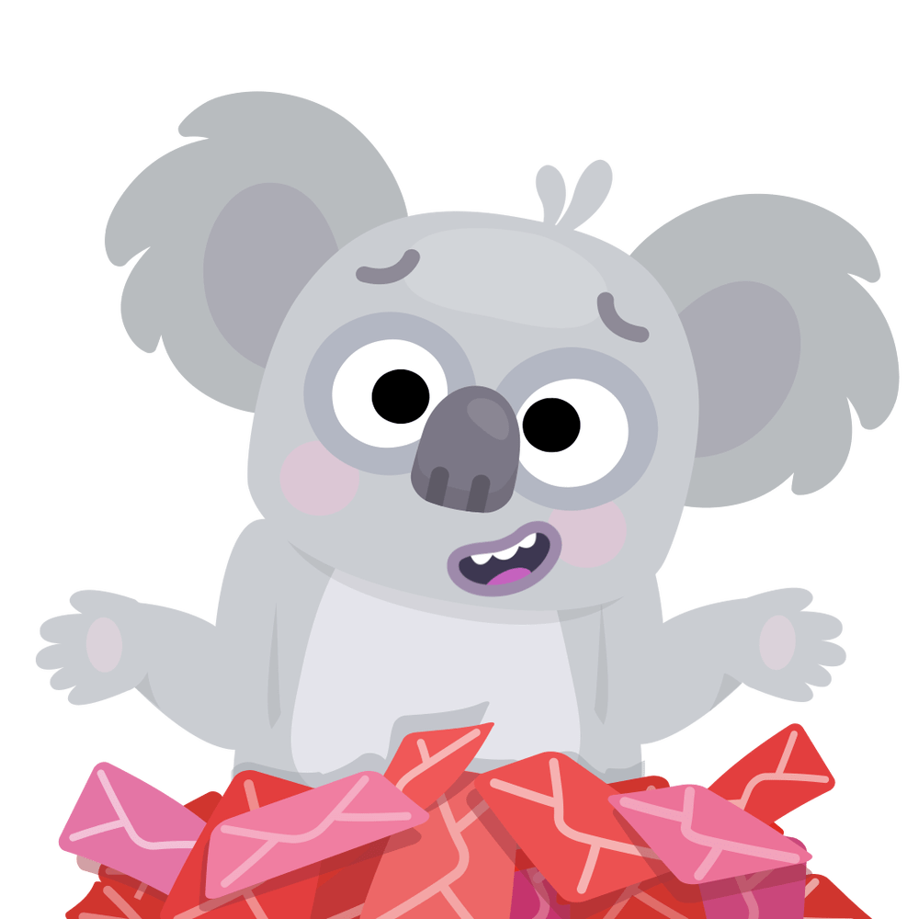
know that I was upset about the quad biking incident. They still brought it up a few times, saying “It wasn’t your fault” or “Mistakes happen, it’s okay”.

Slide 21
know that I was upset about the quad biking incident. They still brought it up a few times, saying “It wasn’t your fault” or “Mistakes happen, it’s okay”.
I hated it all… I didn’t want them to try and make me feel because it just confirmed my thoughts of being as useful as a drop of water trying to fill an empty swimming pool.
I don’t want to end today on a bad note though…

Slide 22
know that I was upset about the quad biking incident. They still brought it up a few times, saying “It wasn’t your fault” or “Mistakes happen, it’s okay”.
I hated it all… I didn’t want them to try and make me feel because it just confirmed my thoughts of being as useful as a drop of water trying to fill an empty swimming pool.
I don’t want to end today on a bad note though…
That made me glad I popped a few pills before bed… herbal anxiety stuff… I have no idea if they actually work or not, but I take them anyway if I feel like my shitty mood is going to get shittier.

Slide 23
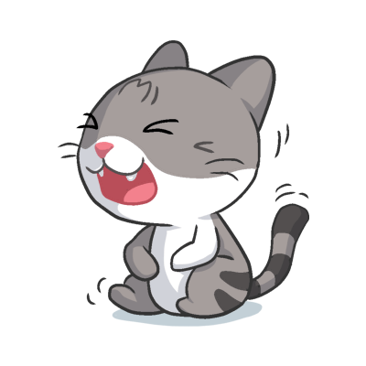
know that I was upset about the quad biking incident. They still brought it up a few times, saying “It wasn’t your fault” or “Mistakes happen, it’s okay”.
I hated it all… I didn’t want them to try and make me feel because it just confirmed my thoughts of being as useful as a drop of water trying to fill an empty swimming pool.
I don’t want to end today on a bad note though…
That made me glad I popped a few pills before bed… herbal anxiety stuff… I have no idea if they actually work or not, but I take them anyway if I feel like my shitty mood is going to get shittier.
After dinner, we were bored and tired, but we didn’t go to bed
yet. We flipped through channels and found a soapie we used to watch that was now dubbed in English.

Slide 24
know that I was upset about the quad biking incident. They still brought it up a few times, saying “It wasn’t your fault” or “Mistakes happen, it’s okay”.
I hated it all… I didn’t want them to try and make me feel because it just confirmed my thoughts of being as useful as a drop of water trying to fill an empty swimming pool.
I don’t want to end today on a bad note though…
That made me glad I popped a few pills before bed… herbal anxiety stuff… I have no idea if they actually work or not, but I take them anyway if I feel like my shitty mood is going to get shittier.
After dinner, we were bored and tired, but we didn’t go to bed
yet. We flipped through channels and found a soapie we used to watch that was now dubbed in English.
We watched it and laughed at how silly the voice acting was and how good they used to be back in the day. It got me thinking about the rare good times from when we were younger. We had such a good time that we decided to watch again the following night. I’m not sure if we really will. It seems like we have a lot planned…

Slide 25
know that I was upset about the quad biking incident. They still brought it up a few times, saying “It wasn’t your fault” or “Mistakes happen, it’s okay”.
I hated it all… I didn’t want them to try and make me feel because it just confirmed my thoughts of being as useful as a drop of water trying to fill an empty swimming pool.
I don’t want to end today on a bad note though…
That made me glad I popped a few pills before bed… herbal anxiety stuff… I have no idea if they actually work or not, but I take them anyway if I feel like my shitty mood is going to get shittier.
After dinner, we were bored and tired, but we didn’t go to bed
yet. We flipped through channels and found a soapie we used to watch that was now dubbed in English.
We watched it and laughed at how silly the voice acting was and how good they used to be back in the day. It got me thinking about the rare good times from when we were younger. We had such a good time that we decided to watch again the following night. I’m not sure if we really will. It seems like we have a lot planned…
That makes me nervous, what if I fuck up again? I hate being so bad at everything… Okay, I’m spiraling, which means it’s time for bed.
I just hope tomorrow is much better...

Slide 26
Monday, 15th August 2000
I lost it again… My older sister picked on my hair.
“It’s too curly, you should straighten it instead.”

Slide 27
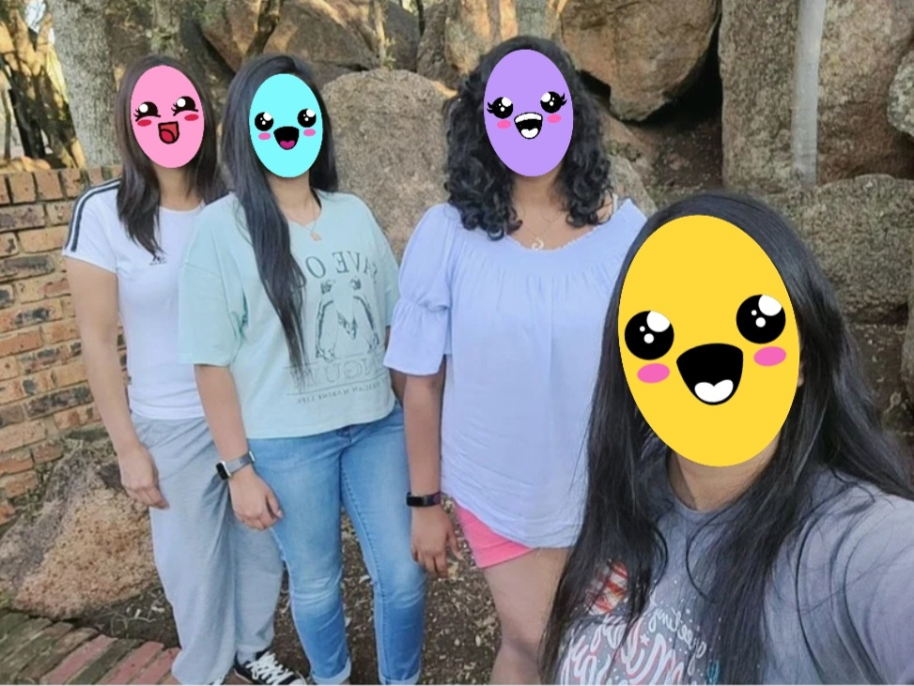
Curly Hair!!!!

Slide 28
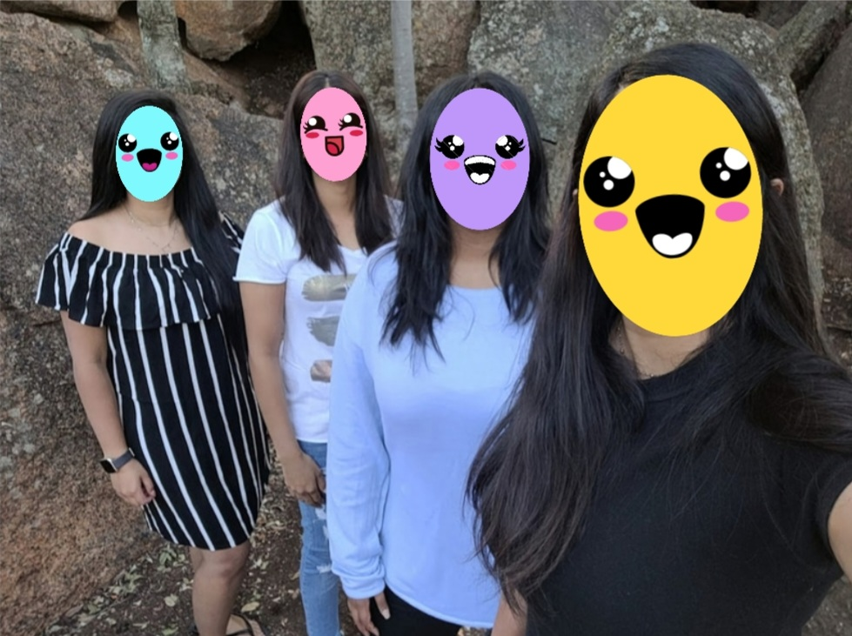
Straight Hair!!!!

Slide 29
Monday, 15th August 2000
I lost it again… My older sister picked on my hair.
“It’s too curly, you should straighten it instead.”
It made me so mad. I was really happy with how it looked for once… I thought it was pretty… I called mummy and asked her for her opinion. She made that face again, the one where she scrunches her nose slightly and wears a fake smile. I knew she was lying but I didn’t want to call her out on it.

Slide 30
Monday, 15th August 2000
I lost it again… My older sister picked on my hair.
“It’s too curly, you should straighten it instead.”
It made me so mad. I was really happy with how it looked for once… I thought it was pretty… I called mummy and asked her for her opinion. She made that face again, the one where she scrunches her nose slightly and wears a fake smile. I knew she was lying but I didn’t want to call her out on it.
I went to straighten it instead, just to make everyone else happy again. Their words were stuck in my head. They kept replaying in my head, over and over and over again. Before I knew it, smoke was everywhere. I let go of the straightener and saw a
clump of hair still attached to the straightener.

Slide 31
Monday, 15th August 2000
I lost it again… My older sister picked on my hair.
“It’s too curly, you should straighten it instead.”
It made me so mad. I was really happy with how it looked for once… I thought it was pretty… I called mummy and asked her for her opinion. She made that face again, the one where she scrunches her nose slightly and wears a fake smile. I knew she was lying but I didn’t want to call her out on it.
I went to straighten it instead, just to make everyone else happy again. Their words were stuck in my head. They kept replaying in my head, over and over and over again. Before I knew it, smoke was everywhere. I let go of the straightener and saw a
clump of hair still attached to the straightener.
I screamed so loud that my throat ached and felt raw on the inside.
I fought with my sisters and stayed in our chalet for the day. I didn’t want to see them. I’m not sure what I’d end up doing or saying anymore.

Slide 32
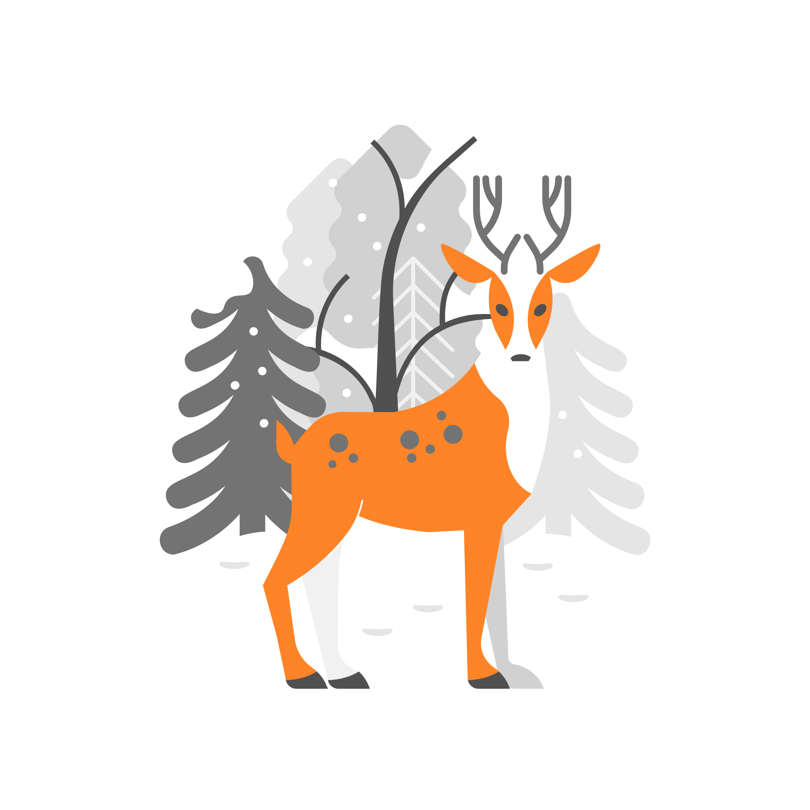
Monday, 15th August 2000
I lost it again… My older sister picked on my hair.
“It’s too curly, you should straighten it instead.”
It made me so mad. I was really happy with how it looked for once… I thought it was pretty… I called mummy and asked her for her opinion. She made that face again, the one where she scrunches her nose slightly and wears a fake smile. I knew she was lying but I didn’t want to call her out on it.
I went to straighten it instead, just to make everyone else happy again. Their words were stuck in my head. They kept replaying in my head, over and over and over again. Before I knew it, smoke was everywhere. I let go of the straightener and saw a
clump of hair still attached to the straightener.
I screamed so loud that my throat ached and felt raw on the inside.
I fought with my sisters and stayed in our chalet for the day. I didn’t want to see them. I’m not sure what I’d end up doing or saying anymore.
I got bored eventually and went for a long walk around the resort. There were so many animals around. From different buck to guinea fowls and even these beaver-like creatures. They were really interesting to watch.

Slide 33
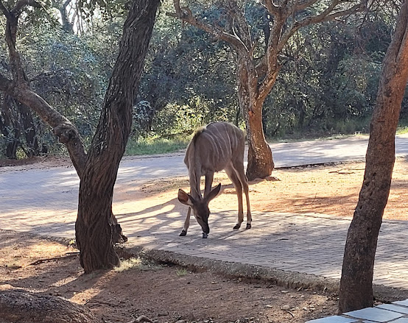
Monday, 15th August 2000
I lost it again… My older sister picked on my hair.
“It’s too curly, you should straighten it instead.”
It made me so mad. I was really happy with how it looked for once… I thought it was pretty… I called mummy and asked her for her opinion. She made that face again, the one where she scrunches her nose slightly and wears a fake smile. I knew she was lying but I didn’t want to call her out on it.
I went to straighten it instead, just to make everyone else happy again. Their words were stuck in my head. They kept replaying in my head, over and over and over again. Before I knew it, smoke was everywhere. I let go of the straightener and saw a

Slide 34
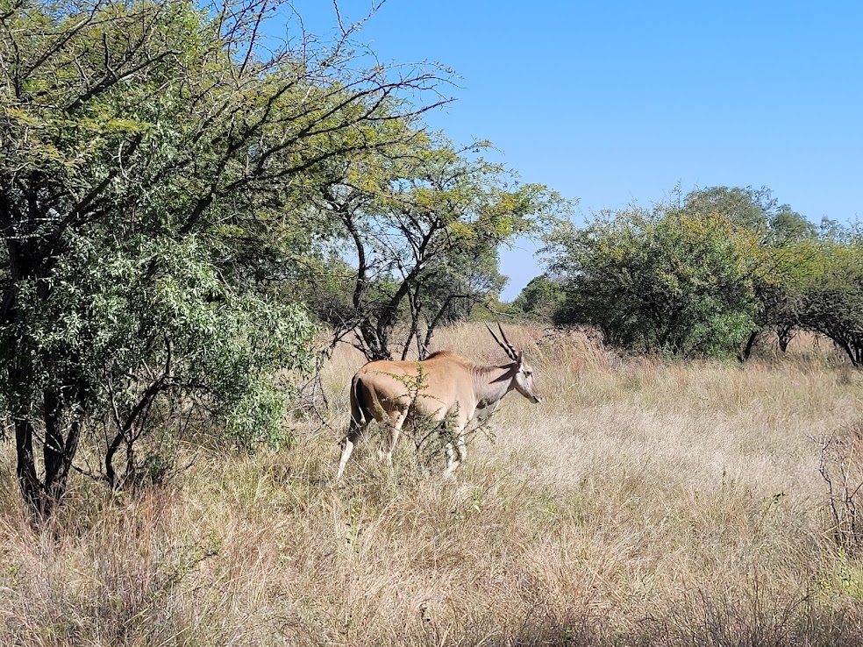
Monday, 15th August 2000
I lost it again… My older sister picked on my hair.
“It’s too curly, you should straighten it instead.”
It made me so mad. I was really happy with how it looked for once… I thought it was pretty… I called mummy and asked her for her opinion. She made that face again, the one where she scrunches her nose slightly and wears a fake smile. I knew she was lying but I didn’t want to call her out on it.
I went to straighten it instead, just to make everyone else happy again. Their words were stuck in my head. They kept replaying in my head, over and over and over again. Before I knew it, smoke was everywhere. I let go of the straightener and saw a

Slide 35
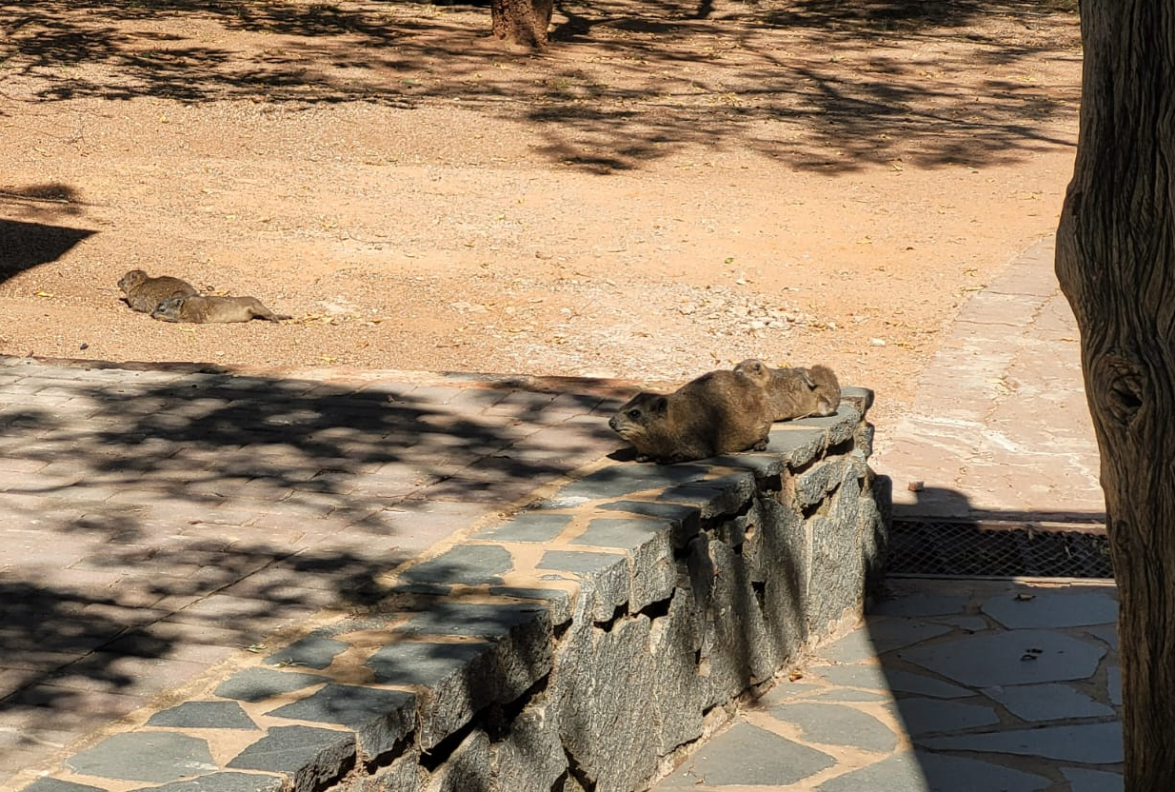
Monday, 15th August 2000
I lost it again… My older sister picked on my hair.
“It’s too curly, you should straighten it instead.”
It made me so mad. I was really happy with how it looked for once… I thought it was pretty… I called mummy and asked her for her opinion. She made that face again, the one where she scrunches her nose slightly and wears a fake smile. I knew she was lying but I didn’t want to call her out on it.
I went to straighten it instead, just to make everyone else happy again. Their words were stuck in my head. They kept replaying in my head, over and over and over again. Before I knew it, smoke was everywhere. I let go of the straightener and saw a

Slide 36
Monday, 15th August 2000
I lost it again… My older sister picked on my hair.
“It’s too curly, you should straighten it instead.”
It made me so mad. I was really happy with how it looked for once… I thought it was pretty… I called mummy and asked her for her opinion. She made that face again, the one where she scrunches her nose slightly and wears a fake smile. I knew she was lying but I didn’t want to call her out on it.
I went to straighten it instead, just to make everyone else happy again. Their words were stuck in my head. They kept replaying in my head, over and over and over again. Before I knew it, smoke was everywhere. I let go of the straightener and saw a
clump of hair still attached to the straightener.
I screamed so loud that my throat ached and felt raw on the inside.
I fought with my sisters and stayed in our chalet for the day. I didn’t want to see them. I’m not sure what I’d end up doing or saying anymore..
I got bored eventually and went for a long walk around the resort. There were so many animals around. From different buck to guinea fowls and even these beaver-like creatures. They were really interesting to watch.
They were like tiny little bears lounging around with even tinier cubs running a mock! I dreaded my sisters coming back home…

Slide 37
But when they did, they were trying to be nice... It was really surprising because that never happened after a fight. They always acted like they’d rather I were dead than deal with me.
Sounds dramatic, but they’ve said it to me on multiple occasions.

Slide 38
But when they did, they were trying to be nice... It was really surprising because that never happened after a fight. They always acted like they’d rather I were dead than deal with me.
Sounds dramatic, but they’ve said it to me on multiple occasions.
I played along with it. I didn’t want to bring it up first.
After dinner, we went to the nearby bar to play pool as if nothing had happened. It irritated me a little, but I could handle it… for the most part.

Slide 39
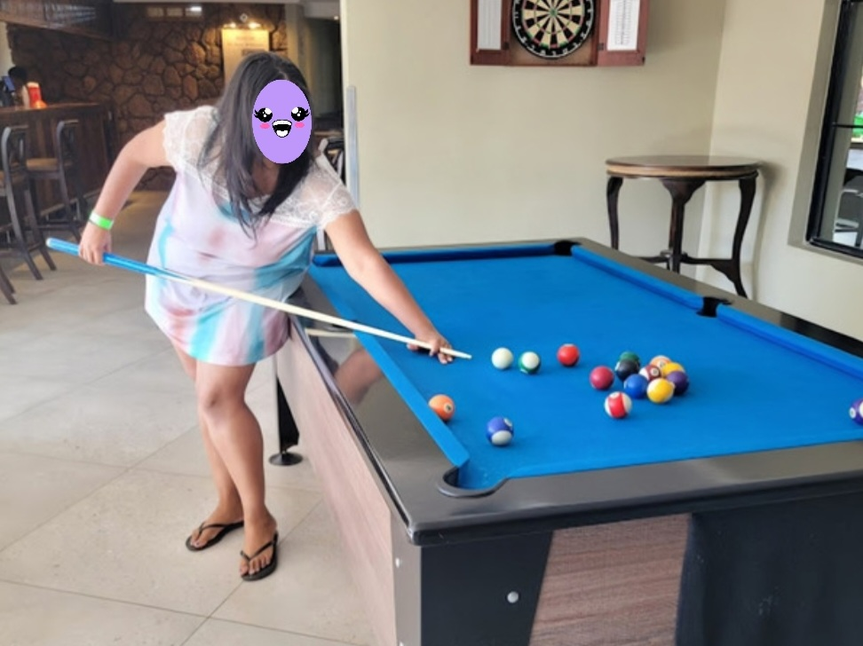

Slide 40
But when they did, they were trying to be nice... It was really surprising because that never happened after a fight. They always acted like they’d rather I were dead than deal with me.
Sounds dramatic, but they’ve said it to me on multiple occasions.
I played along with it. I didn’t want to bring it up first.
After dinner, we went to the nearby bar to play pool as if nothing had happened. It irritated me a little, but I could handle it… for the most part.
After playing a few rounds, we went back home and straight to bed. My hair still smelt burnt and looked odd, but I don’t care right now. All I want is to go home before things get worse, I know they will... I can feel it…

Slide 41
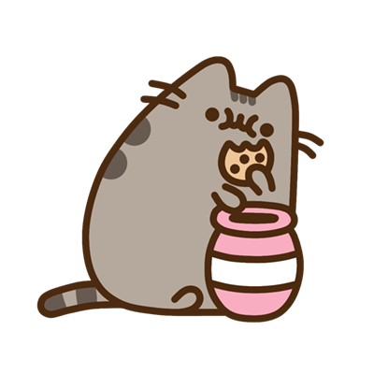
But when they did, they were trying to be nice... It was really surprising because that never happened after a fight. They always acted like they’d rather I were dead than deal with me.
Sounds dramatic, but they’ve said it to me on multiple occasions.
I played along with it. I didn’t want to bring it up first.
After dinner, we went to the nearby bar to play pool as if nothing had happened. It irritated me a little, but I could handle it… for the most part.
After playing a few rounds, we went back home and straight to bed. My hair still smelt burnt and looked odd, but I don’t care right now. All I want is to go home before things get worse, I know they will... I can feel it…
Wednesday, 17th August 2000
Today started off well. No one mentioned yesterday at all, not even the incident. After breakfast, I washed my hair again, hoping to get rid of the burnt smell completely.

Slide 42
But when they did, they were trying to be nice... It was really surprising because that never happened after a fight. They always acted like they’d rather I were dead than deal with me.
Sounds dramatic, but they’ve said it to me on multiple occasions.
I played along with it. I didn’t want to bring it up first.
After dinner, we went to the nearby bar to play pool as if nothing had happened. It irritated me a little, but I could handle it… for the most part.
After playing a few rounds, we went back home and straight to bed. My hair still smelt burnt and looked odd, but I don’t care right now. All I want is to go home before things get worse, I know they will... I can feel it…
Wednesday, 17th August 2000
Today started off well. No one mentioned yesterday at all, not even the incident. After breakfast, I washed my hair again, hoping to get rid of the burnt smell completely.
While I was towel drying my hair, my older sister asked if she could give me a haircut. I figured she was just trying to be nice to me for once.
I let her.

Slide 43
But when they did, they were trying to be nice... It was really surprising because that never happened after a fight. They always acted like they’d rather I were dead than deal with me.
Sounds dramatic, but they’ve said it to me on multiple occasions.
I played along with it. I didn’t want to bring it up first.
After dinner, we went to the nearby bar to play pool as if nothing had happened. It irritated me a little, but I could handle it… for the most part.
After playing a few rounds, we went back home and straight to bed. My hair still smelt burnt and looked odd, but I don’t care right now. All I want is to go home before things get worse, I know they will... I can feel it…
Wednesday, 17th August 2000
Today started off well. No one mentioned yesterday at all, not even the incident. After breakfast, I washed my hair again, hoping to get rid of the burnt smell completely.
While I was towel drying my hair, my older sister asked if she could give me a haircut. I figured she was just trying to be nice to me for once.
I let her.
What a fucking mistake that was…She finally got her revenge.
She went to town, cutting my hair at different lengths everywhere! Some parts were about 3cm long while others were 5 or 10 or 20!

Slide 44
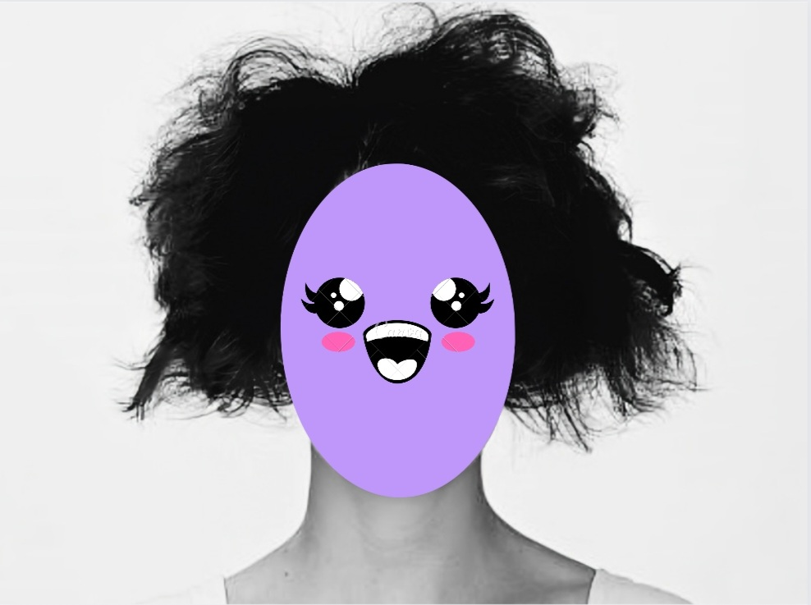
But when they did, they were trying to be nice... It was really surprising because that never happened after a fight. They always acted like they’d rather I were dead than deal with me.
Sounds dramatic, but they’ve said it to me on multiple occasions.
I played along with it. I didn’t want to bring it up first.
After dinner, we went to the nearby bar to play pool as if nothing had happened. It irritated me a little, but I could handle it… for the most part.
After playing a few rounds, we went back home and straight to bed. My hair still smelt burnt and looked odd, but I don’t care right now. All I want is to go home before things get worse, I know they will... I can feel it…

Slide 45
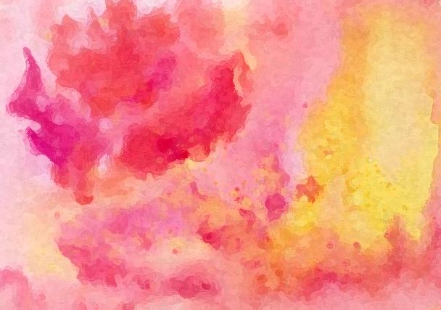
It looked as if a 3-year-old, went to town on my hair.
I was livid. I should have guessed she was going to do this when she sat me down in the kitchen where there were no mirrors in sight.

Slide 46
It looked as if a 3-year-old, went to town on my hair.
I was livid. I should have guessed she was going to do this when she sat me down in the kitchen where there were no mirrors in sight.
I wanted to take the same pair of scissors and pierce them into her eyeballs. The image of doing that was engraved in my mind for the rest of the day. But I didn’t have the guts to do that. Instead, I punctured her car tires.

Slide 47
It looked as if a 3-year-old, went to town on my hair.
I was livid. I should have guessed she was going to do this when she sat me down in the kitchen where there were no mirrors in sight.
I wanted to take the same pair of scissors and pierce them into her eyeballs. The image of doing that was engraved in my mind for the rest of the day. But I didn’t have the guts to do that. Instead, I punctured her car tires.
I didn’t give a shit how we would get home or what people walking by would say. I just did it.
The rest of the day was hazy.. By the time I got home again, it was dark outside.

Slide 48
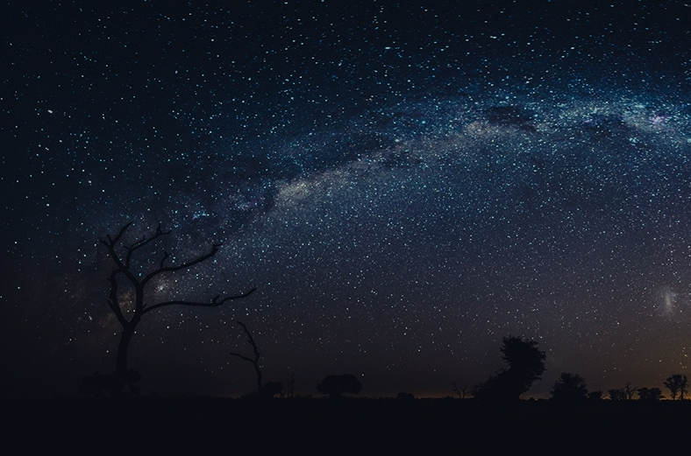

Slide 49
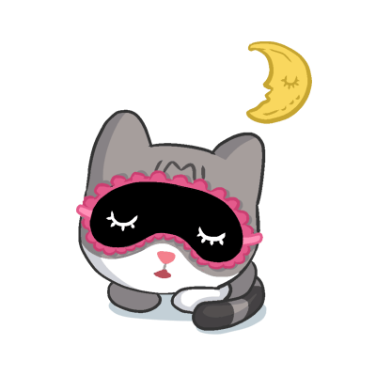
It looked as if a 3-year-old, went to town on my hair.
I was livid. I should have guessed she was going to do this when she sat me down in the kitchen where there were no mirrors in sight.
I wanted to take the same pair of scissors and pierce them into her eyeballs. The image of doing that was engraved in my mind for the rest of the day. But I didn’t have the guts to do that. Instead, I punctured her car tires.
I didn’t give a shit how we would get home or what people walking by would say. I just did it.
The rest of the day was hazy.. By the time I got home again, it was dark outside.
As soon as I walked through the door of our chalet, I jumped into bed and passed out.

Slide 50
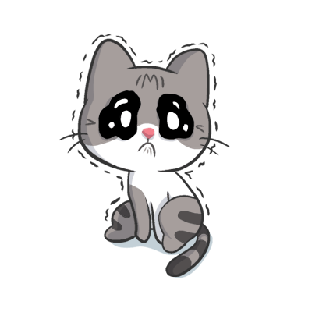
It looked as if a 3-year-old, went to town on my hair.
I was livid. I should have guessed she was going to do this when she sat me down in the kitchen where there were no mirrors in sight.
I wanted to take the same pair of scissors and pierce them into her eyeballs. The image of doing that was engraved in my mind for the rest of the day. But I didn’t have the guts to do that. Instead, I punctured her car tires.
I didn’t give a shit how we would get home or what people walking by would say. I just did it.
The rest of the day was hazy.. By the time I got home again, it was dark outside.
As soon as I walked through the door of our chalet, I jumped into bed and passed out.
I really wish they could have been nicer. Not sure if I regret coming on this trip or not… I most likely do, but I also wish I didn’t have to…

Slide 51
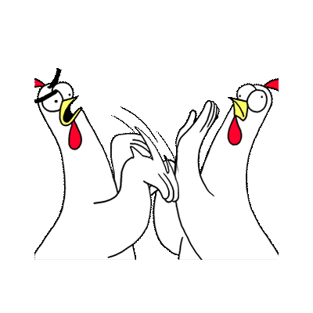
Friday, 19th August 2000
It wasn’t my fault, they made me do it. They just kept pushing me closer and closer to the edge and expected me not to fight back.

Slide 52
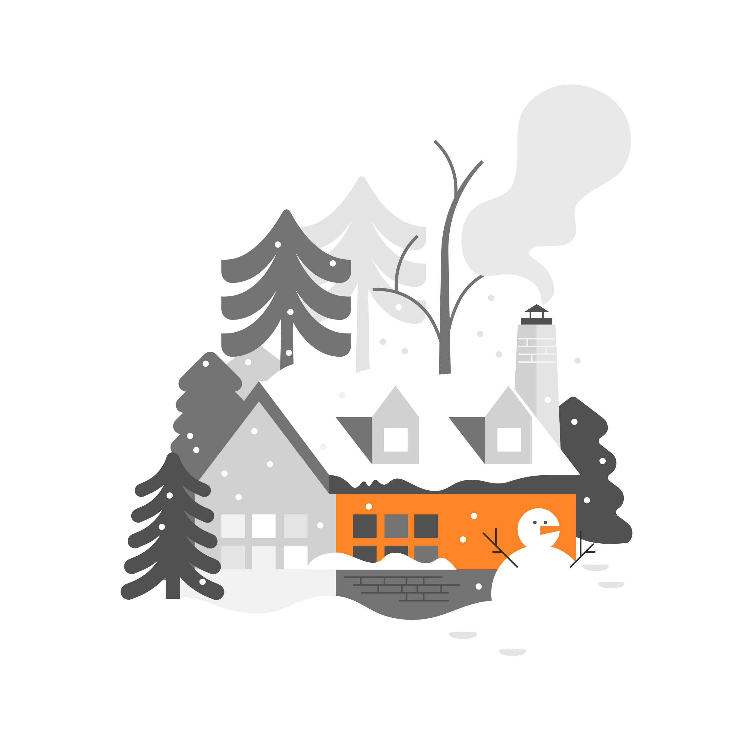
Friday, 19th August 2000
It wasn’t my fault, they made me do it. They just kept pushing me closer and closer to the edge and expected me not to fight back.
My younger sister, she can be a real bitch sometimes. She made side comments throughout breakfast and complained about getting a new tire and how I should have just stayed home.
I glared at her, but that spoilt bitch didn’t care.

Slide 53
Friday, 19th August 2000
It wasn’t my fault, they made me do it. They just kept pushing me closer and closer to the edge and expected me not to fight back.
My younger sister, she can be a real bitch sometimes. She made side comments throughout breakfast and complained about getting a new tire and how I should have just stayed home.
I glared at her, but that spoilt bitch didn’t care.
She made me breakfast and, knowing I’m deadly allergic to nuts, she dumped a whole bag of them on top of my pancakes. Peanuts don’t even go with pancakes! I was quickly getting tired of these games.

Slide 54
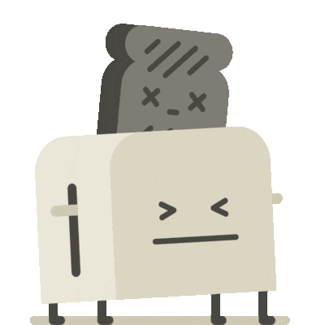
Friday, 19th August 2000
It wasn’t my fault, they made me do it. They just kept pushing me closer and closer to the edge and expected me not to fight back.
My younger sister, she can be a real bitch sometimes. She made side comments throughout breakfast and complained about getting a new tire and how I should have just stayed home.
I glared at her, but that spoilt bitch didn’t care.
She made me breakfast and, knowing I’m deadly allergic to nuts, she dumped a whole bag of them on top of my pancakes. Peanuts don’t even go with pancakes! I was quickly getting tired of these games.
I grabbed her hand and placed it palm down onto the hot stove plate. I know I said something smart, was quite proud of that line but I can’t fucking remember it!

Slide 55
Friday, 19th August 2000
It wasn’t my fault, they made me do it. They just kept pushing me closer and closer to the edge and expected me not to fight back.
My younger sister, she can be a real bitch sometimes. She made side comments throughout breakfast and complained about getting a new tire and how I should have just stayed home.
I glared at her, but that spoilt bitch didn’t care.
She made me breakfast and, knowing I’m deadly allergic to nuts, she dumped a whole bag of them on top of my pancakes. Peanuts don’t even go with pancakes! I was quickly getting tired of these games.
I grabbed her hand and placed it palm down onto the hot stove plate. I know I said something smart, was quite proud of that line but I can’t fucking remember it!
My older sister shoved me away and rushed to place the spoilt bitch’s hand under cold water, as if that would help now.
I laughed as she cried, she deserved it.

Slide 56
Friday, 19th August 2000
It wasn’t my fault, they made me do it. They just kept pushing me closer and closer to the edge and expected me not to fight back.
My younger sister, she can be a real bitch sometimes. She made side comments throughout breakfast and complained about getting a new tire and how I should have just stayed home.
I glared at her, but that spoilt bitch didn’t care.
She made me breakfast and, knowing I’m deadly allergic to nuts, she dumped a whole bag of them on top of my pancakes. Peanuts don’t even go with pancakes! I was quickly getting tired of these games.
I grabbed her hand and placed it palm down onto the hot stove plate. I know I said something smart, was quite proud of that line but I can’t fucking remember it!
My older sister shoved me away and rushed to place the spoilt bitch’s hand under cold water, as if that would help now.
I laughed as she cried, she deserved it.
I had enough of their bullshit. When my older sister started shoving me again, I shoved back. I swore back at her. I argued with her.

Slide 57
Friday, 19th August 2000
It wasn’t my fault, they made me do it. They just kept pushing me closer and closer to the edge and expected me not to fight back.
My younger sister, she can be a real bitch sometimes. She made side comments throughout breakfast and complained about getting a new tire and how I should have just stayed home.
I glared at her, but that spoilt bitch didn’t care.
She made me breakfast and, knowing I’m deadly allergic to nuts, she dumped a whole bag of them on top of my pancakes. Peanuts don’t even go with pancakes! I was quickly getting tired of these games.
I grabbed her hand and placed it palm down onto the hot stove plate. I know I said something smart, was quite proud of that line but I can’t fucking remember it!
My older sister shoved me away and rushed to place the spoilt bitch’s hand under cold water, as if that would help now.
I laughed as she cried, she deserved it.
I had enough of their bullshit. When my older sister started shoving me again, I shoved back. I swore back at her. I argued with her.
I didn’t give a shit how all of this would end anymore.
When she tried to slap me, I knocked her arm away and grabbed, ironically, the same pair of scissors from the other day

Slide 58
and slashed her across the cheek as I smiled.
After that, I went to town. I liked seeing the blood on her face. I slashed at her again and she shouted to ask if I was insane. She really had the audacity to ask that.

Slide 59
and slashed her across the cheek as I smiled.
After that, I went to town. I liked seeing the blood on her face. I slashed at her again and she shouted to ask if I was insane. She really had the audacity to ask that.
I started seeing red. Before I knew it, there were splatters of blood everywhere. My younger sister still stood at the basin, shocked as she stared at our older sister on the floor.
No, I didn’t kill her. I easily could have, but I didn’t.

Slide 60
and slashed her across the cheek as I smiled.
After that, I went to town. I liked seeing the blood on her face. I slashed at her again and she shouted to ask if I was insane. She really had the audacity to ask that.
I started seeing red. Before I knew it, there were splatters of blood everywhere. My younger sister still stood at the basin, shocked as she stared at our older sister on the floor.
No, I didn’t kill her. I easily could have, but I didn’t.
Instead, I grabbed my things from my room (luckily, I didn’t fully unpack and just used everything from my bags). I dumped it all in the car and drove off.
It took a while to get used to driving.

Slide 61
and slashed her across the cheek as I smiled.
After that, I went to town. I liked seeing the blood on her face. I slashed at her again and she shouted to ask if I was insane. She really had the audacity to ask that.
I started seeing red. Before I knew it, there were splatters of blood everywhere. My younger sister still stood at the basin, shocked as she stared at our older sister on the floor.
No, I didn’t kill her. I easily could have, but I didn’t.
Instead, I grabbed my things from my room (luckily, I didn’t fully unpack and just used everything from my bags). I dumped it all in the car and drove off.
It took a while to get used to driving.
I nearly crashed four times, but the road was quiet, so I
was fine. When I was close to home and the roads were getting busier, I pulled over (quite well for someone driving for the first time) and I walked.

Slide 62
and slashed her across the cheek as I smiled.
After that, I went to town. I liked seeing the blood on her face. I slashed at her again and she shouted to ask if I was insane. She really had the audacity to ask that.
I started seeing red. Before I knew it, there were splatters of blood everywhere. My younger sister still stood at the basin, shocked as she stared at our older sister on the floor.
No, I didn’t kill her. I easily could have, but I didn’t.
Instead, I grabbed my things from my room (luckily, I didn’t fully unpack and just used everything from my bags). I dumped it all in the car and drove off.
It took a while to get used to driving.
I nearly crashed four times, but the road was quiet, so I
was fine. When I was close to home and the roads were getting busier, I pulled over (quite well for someone driving for the first time) and I walked.
Seeing the beautiful sunset, I hitchhiked my way around the nearest town. Dangerous, I know but I didn’t care. I just wanted to get as far away from them as I could, otherwise I might actually kill them off.
I just got settled at some B&B for the night.

Slide 63
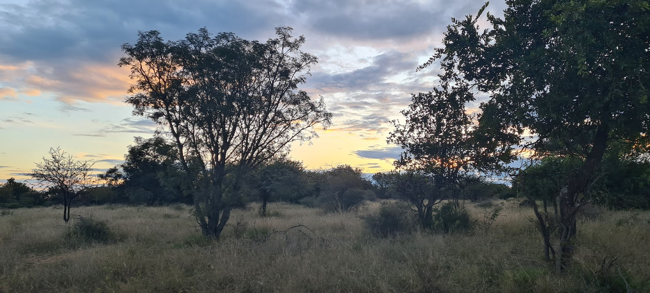
and slashed her across the cheek as I smiled.
After that, I went to town. I liked seeing the blood on her face. I slashed at her again and she shouted to ask if I was insane. She really had the audacity to ask that.
I started seeing red. Before I knew it, there were splatters of blood everywhere. My younger sister still stood at the basin, shocked as she stared at our older sister on the floor.
No, I didn’t kill her. I easily could have, but I didn’t.
Instead, I grabbed my things from my room (luckily, I didn’t fully unpack and just used everything from my bags). I dumped it all in the car and drove off.
It took a while to get used to driving.

Slide 64
and slashed her across the cheek as I smiled.
After that, I went to town. I liked seeing the blood on her face. I slashed at her again and she shouted to ask if I was insane. She really had the audacity to ask that.
I started seeing red. Before I knew it, there were splatters of blood everywhere. My younger sister still stood at the basin, shocked as she stared at our older sister on the floor.
No, I didn’t kill her. I easily could have, but I didn’t.
Instead, I grabbed my things from my room (luckily, I didn’t fully unpack and just used everything from my bags). I dumped it all in the car and drove off.
It took a while to get used to driving.
I nearly crashed four times, but the road was quiet, so I
was fine. When I was close to home and the roads were getting busier, I pulled over (quite well for someone driving for the first time) and I walked.
Seeing the beautiful sunset, I hitchhiked my way around the nearest town. Dangerous, I know but I didn’t care. I just wanted to get as far away from them as I could, otherwise I might actually kill them off.
I just got settled at some B&B for the night.
I didn’t have a lot of money on me, but it was enough for a week.
All I need is a warm bed and water, I’ll be fine… Because I can FINALLY breathe in peace again, even if it’s for a little while.

